Slide 1
An Introduction to gRPC
A scalable alternative
Suresh KV

Slide 2
Agenda

Slide 3
A brief history
90s
CORBA - 1991
Microsoft COM - 1993
00s
SOAP - 1998
REST - 2000
10s
gRPC - 2015
GraphQL - 2015

Slide 4

What would RPC say to REST?

Slide 5
Now, what’s on your mind?
Yet another RPC?
Don’t worry, we are not taking you back to 90s

Slide 6
gRPC - Overview
Client - go
gRPC Stub
Proto Request
Protocol
Buffers
Define RPC Service
Define Request and Response Messages
Microservice - go
Proto Response
gRPC Server
Proto Response
Client – python
Proto Request
gRPC Stub
gRPC can use protocol buffers as both its Interface Definition Language (IDL) and as its underlying message interchange format

Slide 7
gRPC in Action
Proto File
Create a proto file to define the service and the message payload
Code Generation
Generate gRPC code to languages of choice from the proto files
Server
Implement server in language of choice
Client
Implement client in language of choice to invoke the service through the stub

Slide 8
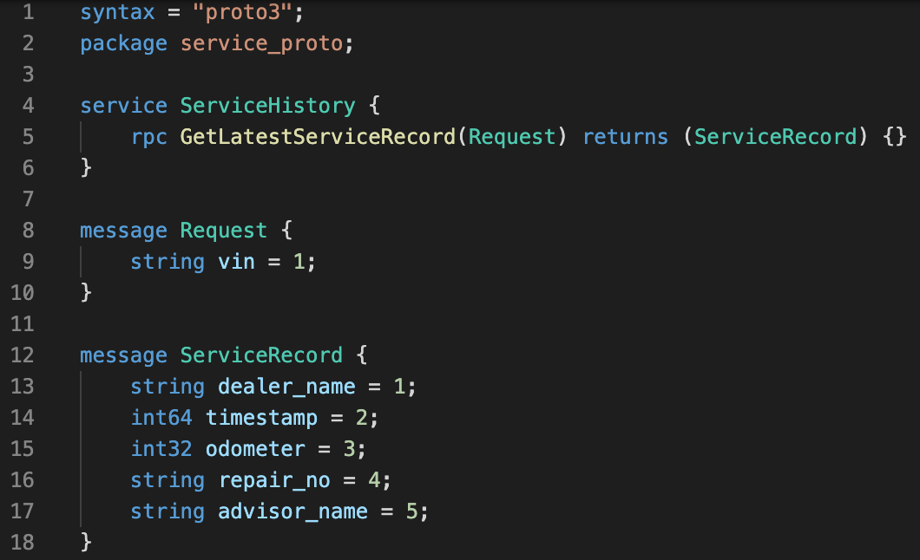
gRPC in Action – Proto File
Service Definition:
Unary RPC
Client Streaming RPC
Server Streaming RPC
Bidirectional Streaming RPC
Message Definition:
Define request and response message format

Slide 9
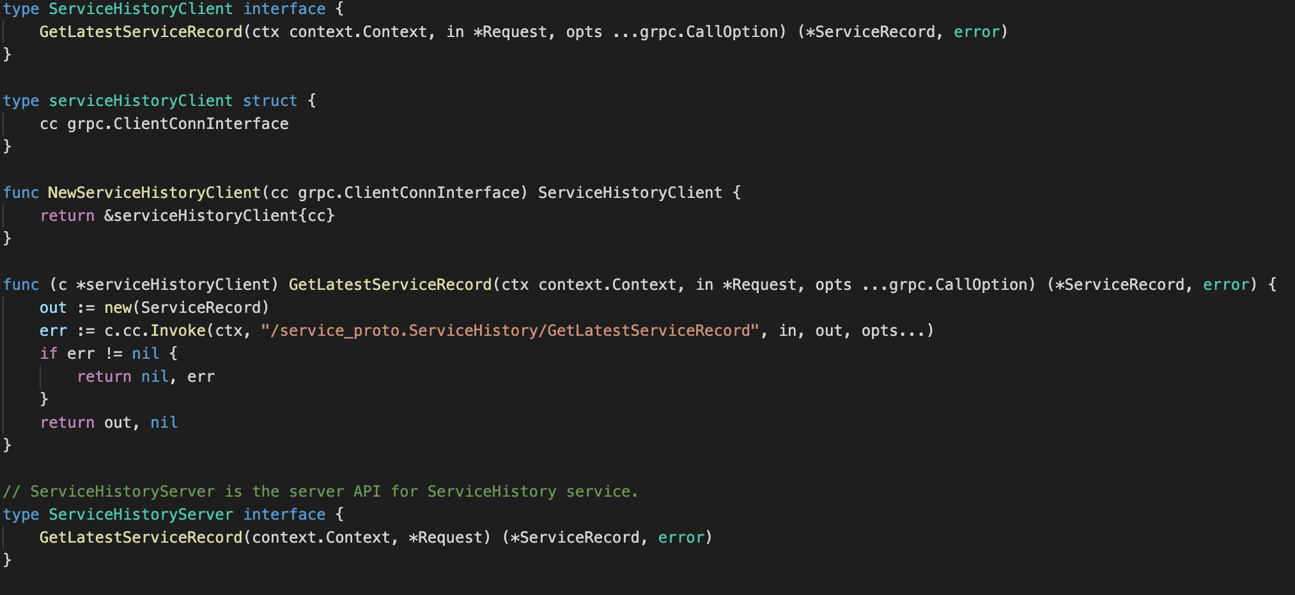
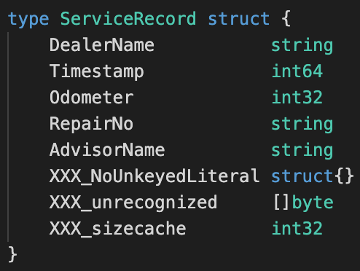
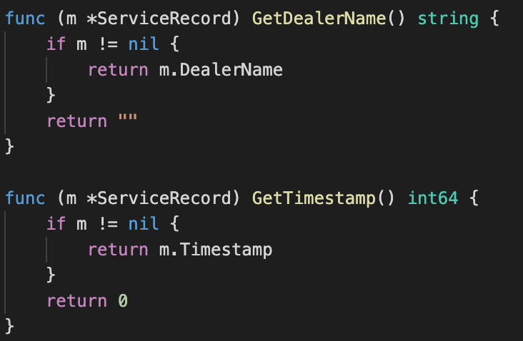
gRPC in Action – Generating go code
protoc -I=. --go_out=plugins=grpc,paths=source_relative:../../service_proto/ servicerecord.proto
1
Interface for service definition
1
2
Objects for messages
3
Getters and setters for the fields
2
3

Slide 10
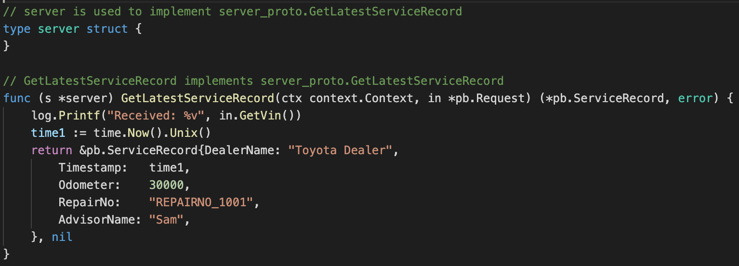
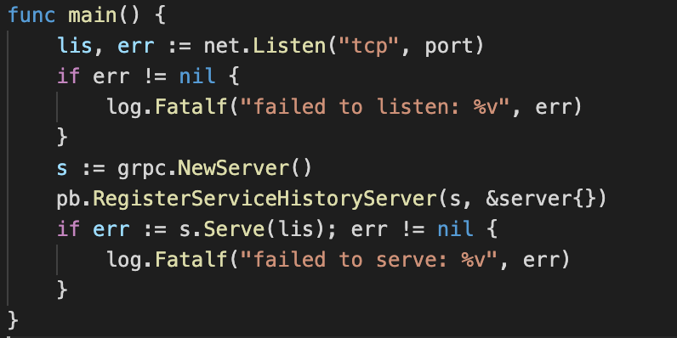
gRPC in Action – Define Server
Define server by defining a server struct type that implements the generated ServiceHistoryServer interface
Some server code!!

Slide 11
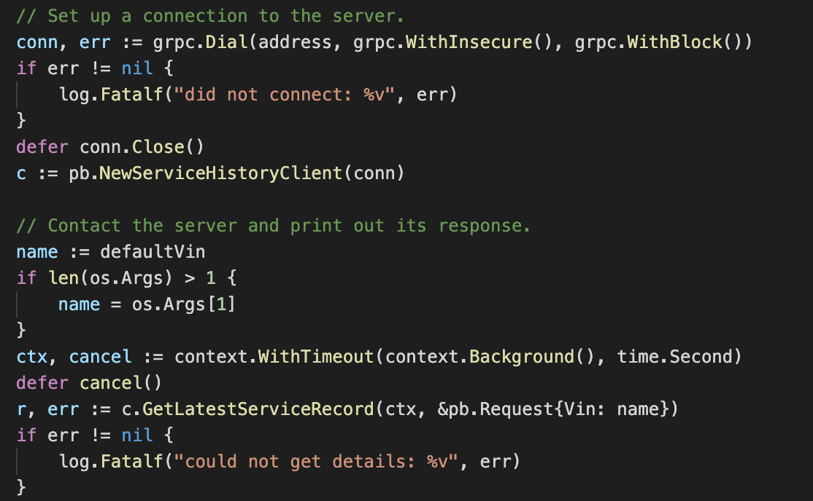
gRPC in Action – Invoke Server From Client
Client Code!
Setup a connection
Create client instance
Invoke the service

Slide 12
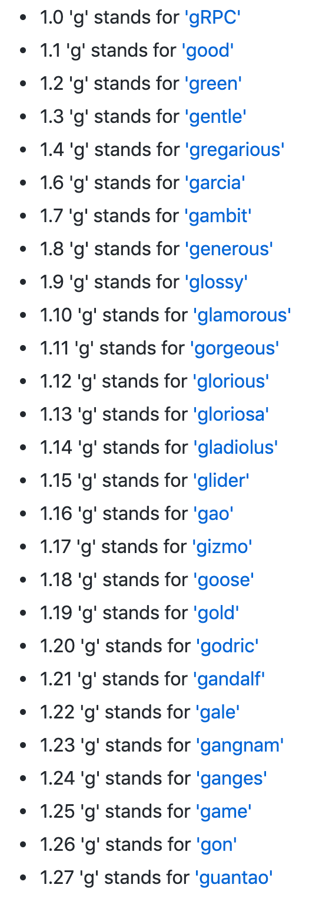
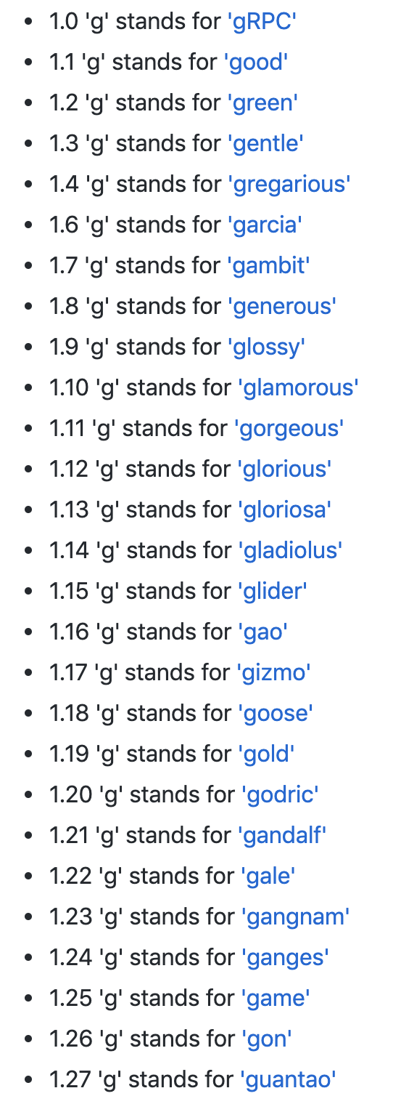
Trivia - gRPC Remote Procedure Calls, of course!
https://github.com/grpc/grpc/blob/master/doc/g_stands_for.md

Slide 13
gRPC Principles
Services not Objects, Messages not References
Coverage & Simplicity
Free & Open
Interoperability & Reach
General Purpose & Performant
Layered
Payload Agnostic
Streaming
Blocking & Non-Blocking
Cancellation & Timeout
Lameducking
Flow-Control
Pluggable
Extensions as APIs
Metadata Exchange
Standardized Status Codes
https://grpc.io/blog/principles/

Slide 14
In short - why gRPC?
Multi Language Support
Extensible
Payload Agnostic
Simplicity
Performant
Streaming
Service Contract

Slide 15
gRPC - Under the Hood
https://grpc.io/blog/http2_smarter_at_scale/
https://grpc.io/blog/grpc_on_http2/

Slide 16
Thank You

